Slide 1
COURSE CODE:
INFT 352
TITLE:
Advanced Web Engineering and Application With PHP
LECTURER/ INSTRUCTOR: P.M SARFO

Slide 2
Upload Image into Database and Display it using PHP.

Slide 3
Server-side file upload can be easily implemented using PHP.
There are various ways available to upload image to server and display images on the webpage.
Generally, in a dynamic web application, the uploaded image is stored in a directory of the server and the file name is inserted in the database.
Later, the images are retrieved from the server based on the file name stored in the database and display on the web page.

Slide 4
The image can be uploaded directly to the database without storing on the server.
But it will increase the database size and web page load time. So, it’s always a good idea to upload images to the server and store file names in the database.

Slide 5
In this tutorial, we will show you the entire process to upload and store the image file in MySQL database using PHP.
The example code demonstrates the process to implement the file upload functionality in the web application and the following functionality will be implemented.
HTML form to upload image.
Upload image to server using PHP.
Store file name in the database using PHP and MySQL.
Retrieve images from the database and display in the web page.

Slide 6
Files Needed
db.php → PDO database connection file
index.php → Upload form
upload.php → Upload handler + DB insert
preview.php → Displays uploaded file info & preview

Slide 7
1. Create Datbase Table
To store the image file name a table need to be created in the database. The following SQL creates an images table with some basic fields in the MySQL database.

Slide 8
2. Database Configuration (db.php)
The dbConfig.php file is used to connect and select the MySQL database.
Specify the database hostname ($dbHost), username ($dbUsername), password ($dbPassword), and name ($dbName) as per your MySQL credentials.

Slide 9
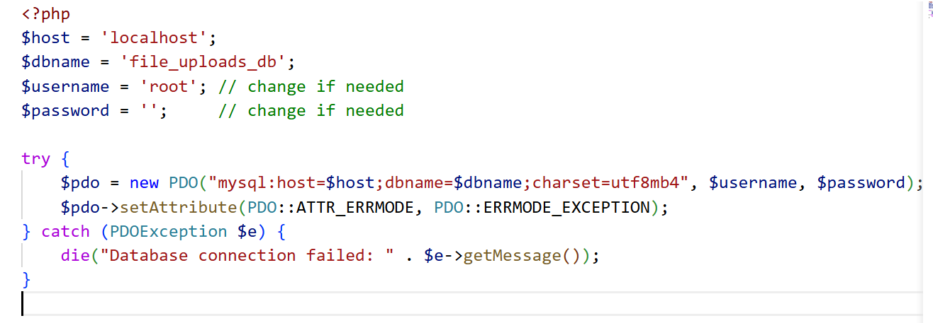
Notes:
<?php
$host = 'localhost';
$dbname = 'file_uploads_db';
$username = 'root'; // change if needed
$password = ''; // change if needed
try {
$pdo = new PDO("mysql:host=$host;dbname=$dbname;charset=utf8mb4", $username, $password);
$pdo->setAttribute(PDO::ATTR_ERRMODE, PDO::ERRMODE_EXCEPTION);
} catch (PDOException $e) {
die("Database connection failed: " . $e->getMessage());
}

Slide 10
Upload Form HTML (index.php)
Create an HTML form to allow the user to choose a file they want to upload. Make sure <form> tag contains the following attributes.
method="post"
enctype="multipart/form-data“
The file upload form will be submitted to the upload.php file to upload image to the server.
Notes:
<!doctype html>
<html lang="en">
<head>
<meta charset="utf-8">
<title>File Upload</title>
<style>
body { font-family: Arial, sans-serif; padding: 20px; }
</style>
</head>
<body>
<h1>Upload a File (image, pdf, mp4, etc.)</h1>
<form action="upload.php" method="post" enctype="multipart/form-data">
<label for="file">Choose file:</label><br>
<input type="file" name="file" id="file" required>
<p style="font-size:0.9rem; color:#555;">Max size: 50MB. Uploaded files go to /uploads</p>
<button type="submit">Upload</button>
</form>
</body>
</html>

Slide 11
Upload File to Server and Store in Database (upload.php)
The upload.php file handles the image upload functionality and shows the status message to the user.
Include the database configuration file to connect and select the MySQL database.
Get the file extension using pathinfo() function in PHP and validate the file format to check whether the user selects an image file.
Upload image to server using move_uploaded_file() function in PHP.
Insert image file name in the MySQL database using PHP.
Upload status will be shown to the user.
Notes:
<?php
require 'db.php'; // include database connection
$uploadDir = __DIR__ . '/uploads';
$maxFileSize = 50 * 1024 * 1024; // 50MB
if (!is_dir($uploadDir)) {
mkdir($uploadDir, 0755, true);
}
if ($_SERVER['REQUEST_METHOD'] === 'POST' && isset($_FILES['file'])) {
$file = $_FILES['file'];
if ($file['error'] !== UPLOAD_ERR_OK) {
die("Error uploading file. Code: " . $file['error']);
}
if ($file['size'] > $maxFileSize) {
die("File exceeds maximum size of 50MB.");
}
$finfo = new finfo(FILEINFO_MIME_TYPE);
$mime = $finfo->file($file['tmp_name']) ?: 'application/octet-stream';
$origName = pathinfo($file['name'], PATHINFO_FILENAME);
$origExt = pathinfo($file['name'], PATHINFO_EXTENSION);
$safeBase = preg_replace('/[^A-Za-z0-9_\-]/', '_', $origName);
$unique = $safeBase . '_' . time();
$finalName = $unique . ($origExt ? '.' . $origExt : '');
$destination = $uploadDir . '/' . $finalName;
if (!move_uploaded_file($file['tmp_name'], $destination)) {
die("Failed to move uploaded file.");
}
chmod($destination, 0644);
// Store file info in database
$stmt = $pdo->prepare("INSERT INTO uploads (filename, original_name, mime_type, file_size) VALUES (:filename, :original_name, :mime_type, :file_size)");
$stmt->execute([
':filename' => $finalName,
':original_name' => $file['name'],
':mime_type' => $mime,
':file_size' => $file['size']
]);
$fileId = $pdo->lastInsertId();
// Redirect to preview
header("Location: preview.php?id=" . $fileId);
exit;
}

Slide 12
Preview / Display Images from Database
Now we will retrieve the uploaded images from the server based on the file names in the database and display images in the web page.
Include the database configuration file.
Fetch images from MySQL database using PHP.
List images from the uploads directory of the server.
Notes:
<?php
require 'db.php';
$id = $_GET['id'] ?? 0;
$stmt = $pdo->prepare("SELECT * FROM uploads WHERE id = ?");
$stmt->execute([$id]);
$fileData = $stmt->fetch(PDO::FETCH_ASSOC);
if (!$fileData) {
die("File not found in database.");
}
$filePath = 'uploads/' . $fileData['filename'];
if (!file_exists($filePath)) {
die("File not found on server.");
}
?>
<!doctype html>
<html lang="en">
<head>
<meta charset="utf-8">
<title>File Preview</title>
<style>
body { font-family: Arial, sans-serif; padding: 20px; }
img, video { max-width: 100%; height: auto; }
iframe { border: none; }
</style>
</head>
<body>
<h1>File Uploaded Successfully</h1>
<p><strong>Original name:</strong> <?= htmlspecialchars($fileData['original_name']) ?></p>
<p><strong>MIME type:</strong> <?= htmlspecialchars($fileData['mime_type']) ?></p>
<p><strong>Size:</strong> <?= round($fileData['file_size'] / 1024, 2) ?> KB</p>
<p><strong>Uploaded on:</strong> <?= htmlspecialchars($fileData['upload_date']) ?></p>
<?php if (strpos($fileData['mime_type'], 'image/') === 0): ?>
<h3>Image Preview</h3>
<img src="<?= htmlspecialchars($filePath) ?>" alt="Uploaded image">
<p><a href="<?= htmlspecialchars($filePath) ?>" download>Download Image</a></p>
<?php elseif ($fileData['mime_type'] === 'application/pdf'): ?>
<h3>PDF Preview</h3>
<iframe src="<?= htmlspecialchars($filePath) ?>" width="100%" height="600"></iframe>
<p><a href="<?= htmlspecialchars($filePath) ?>" download>Download PDF</a></p>
<?php elseif (strpos($fileData['mime_type'], 'video/') === 0): ?>
<h3>Video Preview</h3>
<video controls>
<source src="<?= htmlspecialchars($filePath) ?>" type="<?= htmlspecialchars($fileData['mime_type']) ?>">
Your browser does not support the video tag.
</video>
<p><a href="<?= htmlspecialchars($filePath) ?>" download>Download Video</a></p>
<?php else: ?>
<h3>File Uploaded</h3>
<p>This file type cannot be previewed inline. <a href="<?= htmlspecialchars($filePath) ?>" download>Download file</a>.</p>
<?php endif; ?>
<p><a href="index.php">Upload another file</a></p>
</body>
</html>

Slide 13
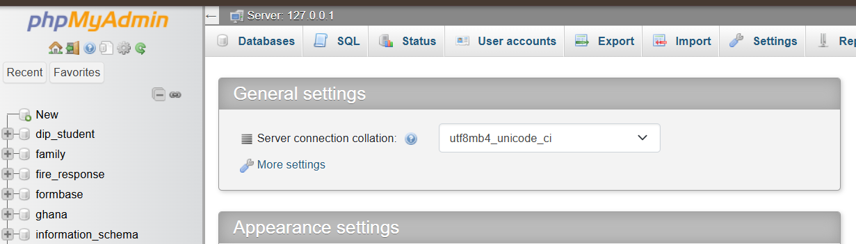
1. Create MySQL Database and Table
Create Database: First, we will create a database named ‘file_uploads_db '. You can use your existing database or create a new one.

Slide 14
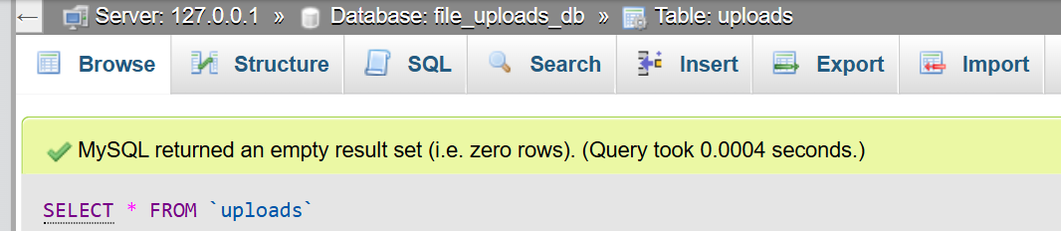

Slide 15
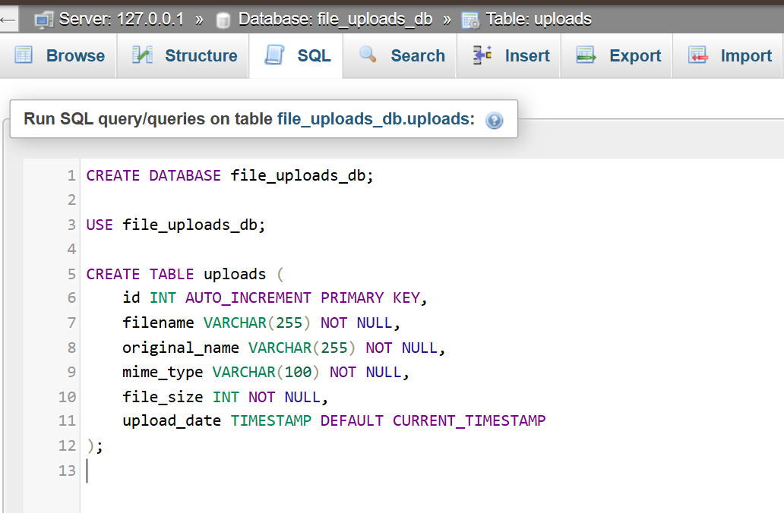
You can create a table by typing the following code into the SQL panel
Notes:
CREATE DATABASE file_uploads_db;
USE file_uploads_db;
CREATE TABLE uploads (
id INT AUTO_INCREMENT PRIMARY KEY,
filename VARCHAR(255) NOT NULL,
original_name VARCHAR(255) NOT NULL,
mime_type VARCHAR(100) NOT NULL,
file_size INT NOT NULL,
upload_date TIMESTAMP DEFAULT CURRENT_TIMESTAMP
);

Slide 16
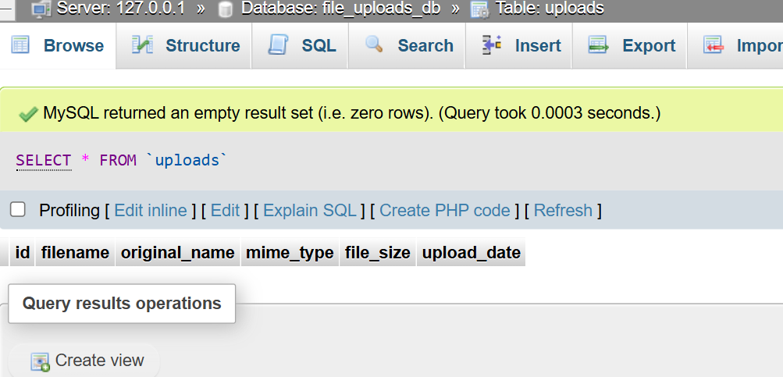

Slide 17
THANK YOU
17

